Slide 1
Strictly for the purpose of BDB demo & Internal Use of Stakeholders
BDB Training
Data Center & Self-Service BI
https://www.bdb.ai

Slide 2
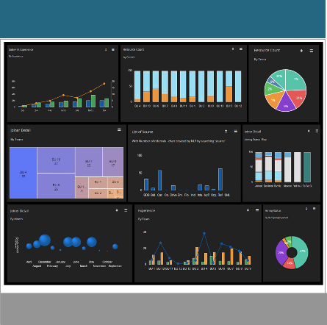
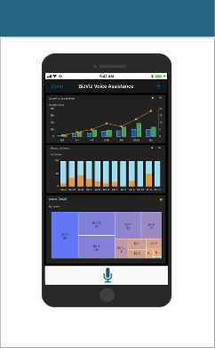
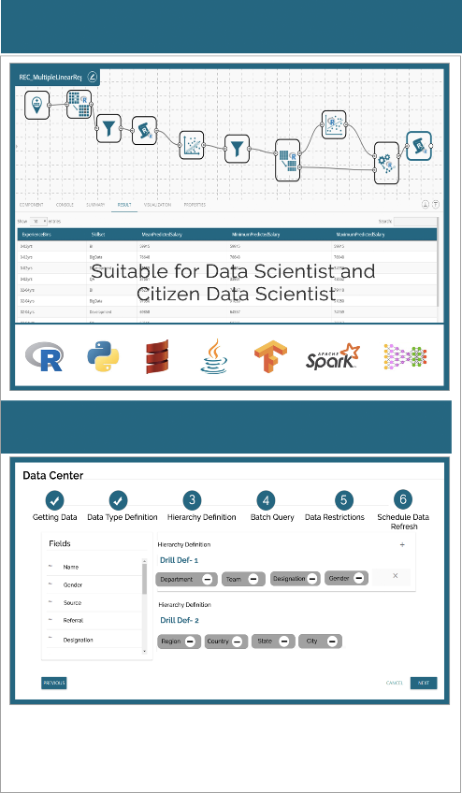
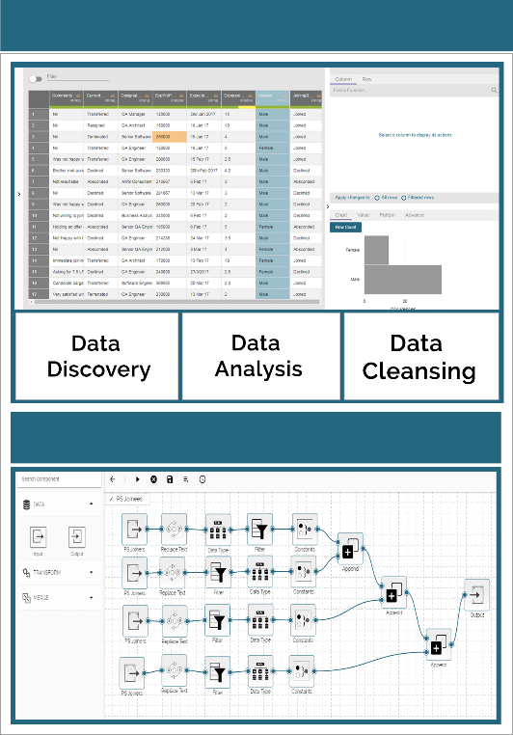
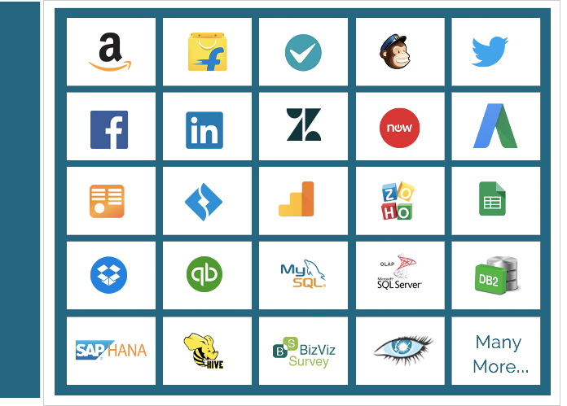
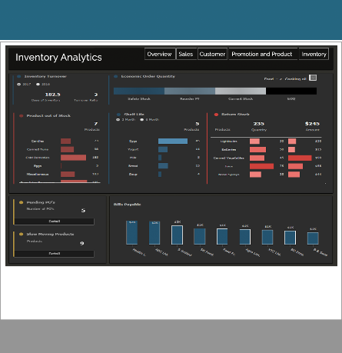
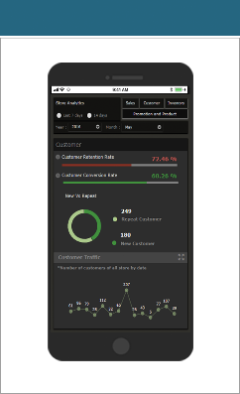
BDB Technology Stack
Mobility
iOS & Android
Self Service BI Dashboard
Self Service BI Dashboard
Enrich & Prepare
Data
Micro Services based Architecture
Rest API based Communication
Horizontally & Vertically Scalable
Predictive & Prescriptive (ML) Workbench (ML)
Data Preparation
B D
B
C
O
N
N
E
C
T
O
R
S
Voice Enabled App
Suitable for Business User
Extract & Blend
Decide
Governed Dashboard
Governed Dashboard
Analyze
Data Store - NLQ
Transform
Secure, Multitenant
Data Analytics Platform with
Hybrid Integration Capabilities
Flatten The Data for Slice & Dice
Suitable for CXOs
Integrated platform &
Server less Big Data Pipeline Architecture

Slide 3
Data Center
Connect and ingest data from any structured, unstructured or semi-structured sources
Data connector: Connectors ranging from RDBMS, Big data and file types to various API connectors like Excel , MySQL, Google Analytics , Cassandra and 40 more
Data sets: It automatically creates Rest API services on top of DB which are further consumed by other plug-ins like data preparation, predictive , dashboard designer
Data Store: Virtual view on top of Databases which is created on elastic server.
Data store meta data: Create the desired structure format to later push data inside via plugins Data Pipeline, Data Preparation.
Refer this link :
https://drive.google.com/open?id=1GEiYYMx3CFGF1cGS-C71SnqQb1iZsebS

Slide 4
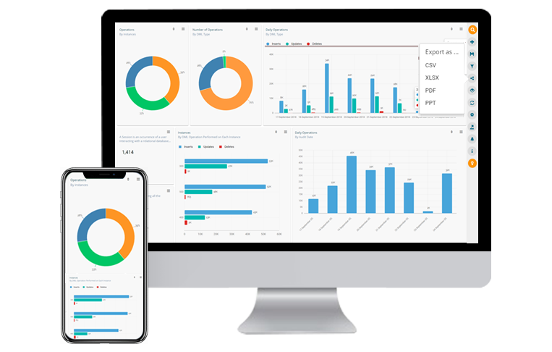
Self-service BI
Drag & drop based user-friendly console to instantly create reports, slice and dice data and generate insights
Embedded with intuitive AI based data search which helps a business user to generate data insights through text search (data query) or Voice Assistance (BDB mobile app) across million of data rows
With feature of BDB Data Insights, explore hidden data insights about any dataset in seconds automatically
Make smarter and quicker business decisions as this module has responsive HTML5 web technology to deploy views on any device- desktop/ tablet/ mobile
Export the analytical reports in PPT/PNG/PDF/ Excel & share across the team to keep them updated
https://bdb.ai/business-story

Slide 5
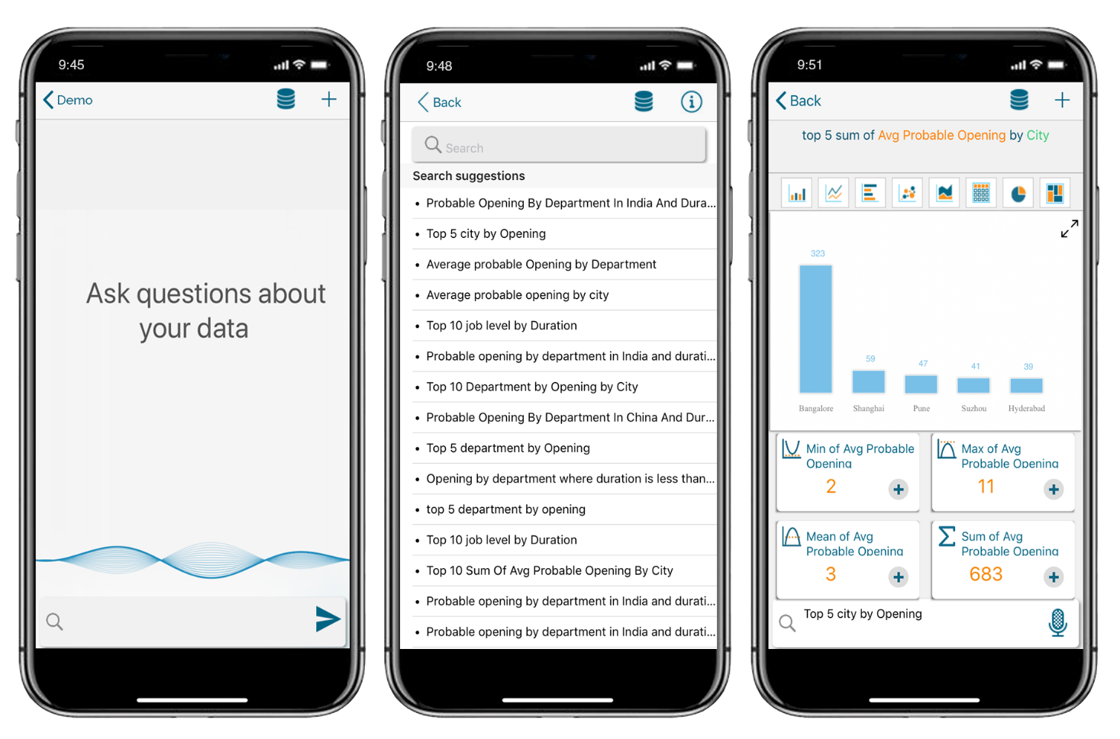
NLQ & Mobility
Drill deeper into your data and create a complete visual report without even using your fingers.
Customize the search to reflect jargon of your organization via adding 'Synonyms' to the data search library.
Normal Data Search feature by Typing a Search Query is also supported in Mobile.
Points to mark while performing NLQ:
Complex query support up to 5 Dimensions and 'n’ no. of measures
Automatic selection of best fitting chart & chart switching
Switch between data stores
Query saving and adding results to story
Intuitive search suggestions
Voice Billing App :
https://www.youtube.com/watch?v=FZjpg7wydog
Conversational Analytics:
https://www.youtube.com/watch?v=d_YWXHHa0g4

Slide 6
Thank you
BDB (Big Data BizViz Technologies)
Copyright © 2018 BDB (Big Data BizViz)
Strictly Confidential
www.bdb.ai

