Slide 1
Strictly for the purpose of BDB demo & Internal Use of Stakeholders
BDB Training
Data Preparation & ETL
https://www.bdb.ai

Slide 2
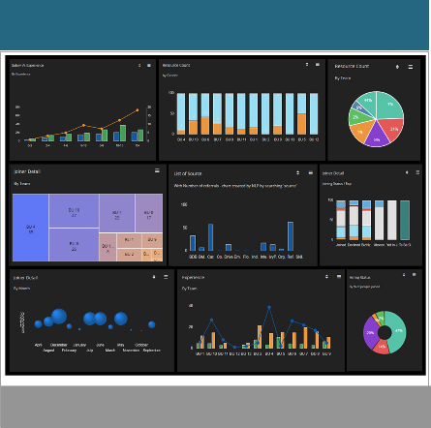
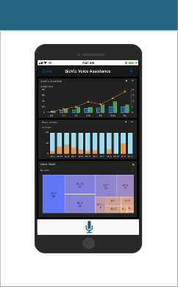
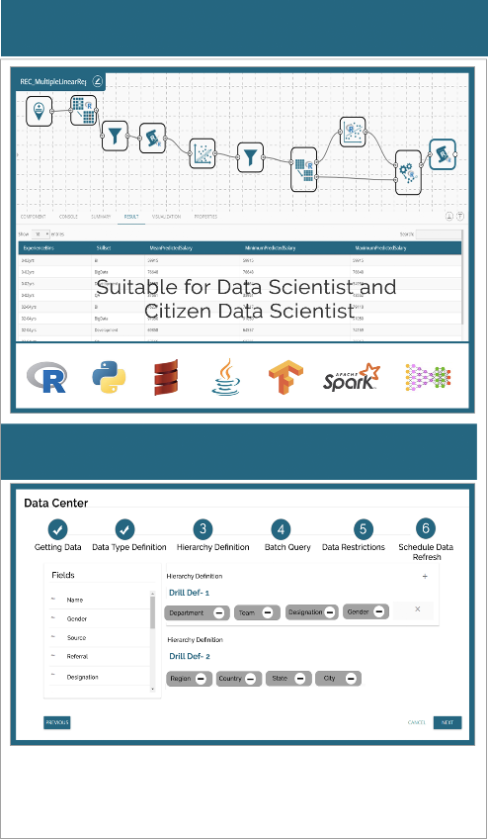
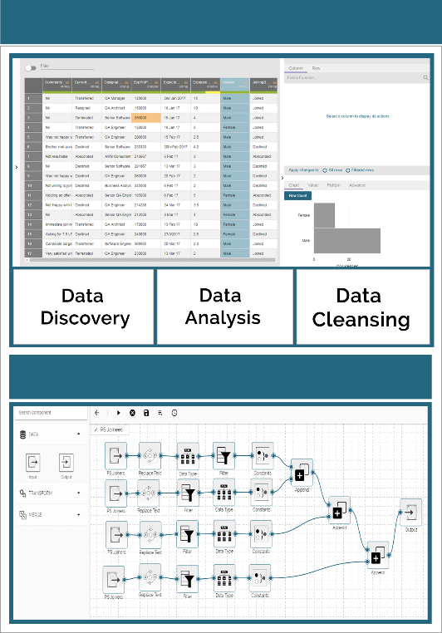
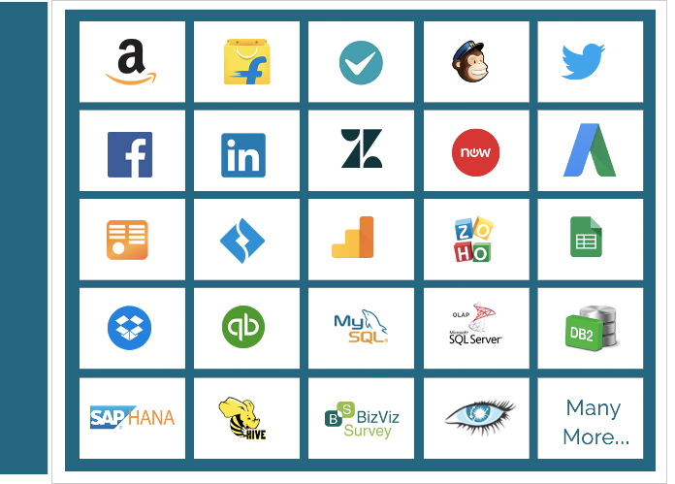
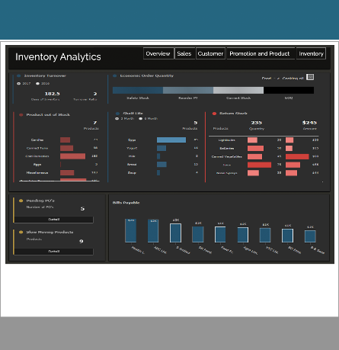
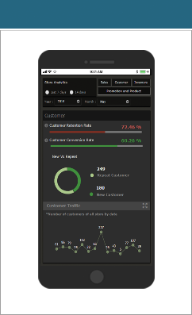
BDB Technology Stack
Mobility
iOS & Android
Self Service BI Dashboard
Self Service BI Dashboard
Enrich & Prepare
Data
Micro Services based Architecture
Rest API based Communication
Horizontally & Vertically Scalable
Predictive & Prescriptive (ML) Workbench (ML)
Data Preparation
B D
B
C
O
N
N
E
C
T
O
R
S
Voice Enabled App
Suitable for Business User
Extract & Blend
Decide
Governed Dashboard
Governed Dashboard
Analyze
Data Store - NLQ
Transform
Secure, Multitenant
Data Analytics Platform with
Hybrid Integration Capabilities
Flatten The Data for Slice & Dice
Suitable for CXOs
Integrated platform &
Server less Big Data Pipeline Architecture

Slide 3
ETL
Extract data from data sources, Transform with the available transformation component & Load it into RDBMS/ Data Lake/ Elastic Cube
Improve data quality & data governance
Helps to automate manual transformation effort
Extract-Merge Data Sets- Enrich-Load through easy to create workflows and avoid writing codes
Embedded Data Preparation Tool which helps in data cleansing up to a deeper level
BDB self service Data Preparation is excel-like tool with End-to-end profiling, cleansing, transformation capabilities that enable you to identify anomalies, standardize data, resolve duplicates, and enhance data quality over time.
Data Preparation
Visualize entire data set in familiar grid format, monitor anomalies on the values within each column using data quality bar.
Get interactive data exploration, profile charts & transform with filters & 50+data transformations
Data analysts can instantly detect anomalous records and purge the unwanted data sets using Machine-Learning based smart techniques and sampling
Push the transformed data into ETL/Pipeline workflows or extract the transformation recipe and

Slide 4
Thank you
BDB (Big Data BizViz Technologies)
Copyright © 2018 BDB (Big Data BizViz)
Strictly Confidential
www.bdb.ai

